Slide 1
ProCEDURAL TERRAIN GENERATION WITH LOD
ALPHA PRESENTATION

Slide 2
DEMO

Slide 3
PROJECT MILESTONES
Get acquainted with tessellation shader pipeline
Use programmable tesselation control shader and tessellation evaluation shader
Implement dynamic LOD system based on projected size of edges in screen space
Generate terrain procedurally using noise functions
Render terrain procedurally
Extract normals from height map
Shade the terrain based on slope (eg: snow)
Different shader for water

Slide 4
PROJECT MILESTONES
Get acquainted with tessellation shader pipeline
Use programmable tesselation control shader and tessellation evaluation shader
Implement dynamic LOD system based on projected size of edges in screen space
Generate terrain procedurally using noise functions
Render terrain procedurally
Extract normals from height map
Shade the terrain based on slope (eg: snow)
Different shader for water

Slide 5
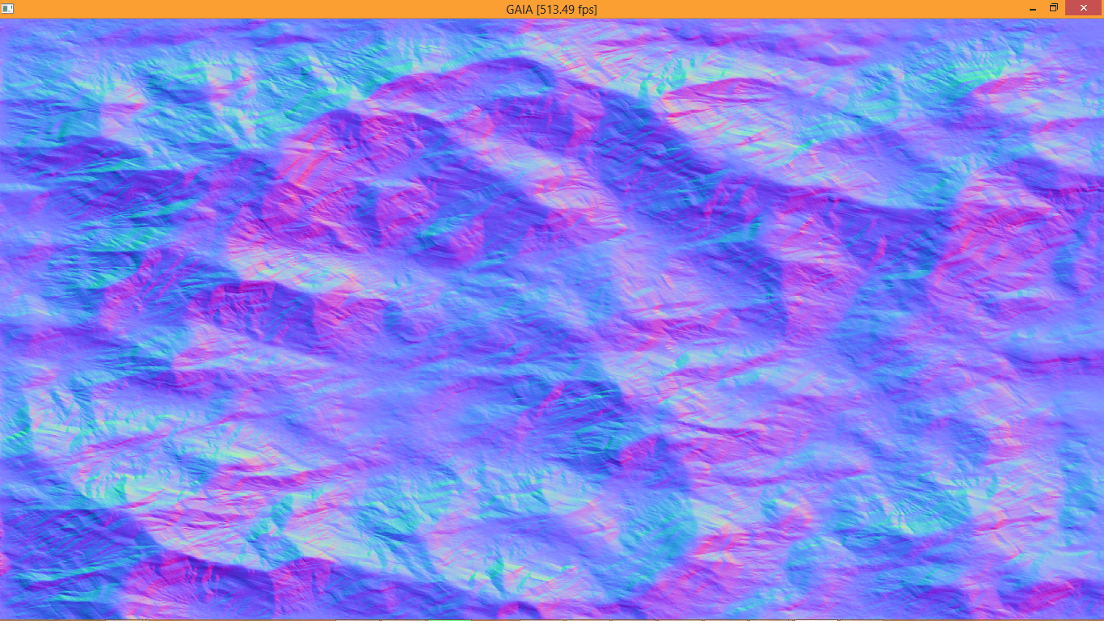

Slide 6


Slide 7
“BUT WHAT WOULD BE
REALLY REALLY
REALLY COOL…”
- Liam

Slide 8
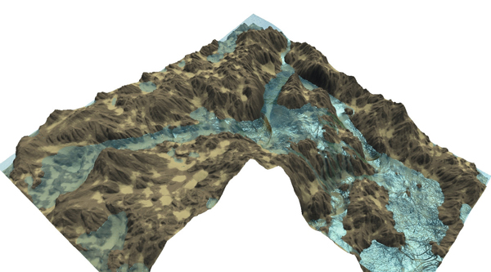
… TERRAIN MODELING USING EROSION

Slide 9
REFERENCES
OpenGL Insights by Patrick Cozzi and Christopher Riccio
GPU Pro4 Advanced Rendering by Wolfgang Engel
Interactive terrain modeling using hydraulic erosion, by Ondrej et al
Cellular automata model for Soil Erosion by Water, by D’Ambrosio et al

